Slide 1

IoT-Based Farmer Helper
Review -1
Names:
Thameemul Ansari U 22MIS1140
Shirish S 22MIS1121

Slide 2
OVERVIEW
This project is an IoT + AI based Farmer Helper Pocket Device designed for Indian farmers.
Many farmers don’t have smartphones or find mobile apps difficult to use.
So this device works as a small stand-alone assistant with a screen + buttons.
Farmers can get crop guidance, weather details, disease detection support, and market price updates.
It supports online connectivity for live updates and API usage.
The goal is to bring AI support to rural areas in a simple and low-cost way.
The device is portable, easy to carry, and can be used anytime on the field.

Slide 3
OBJECTIVE
To develop a portable farmer-friendly device that works without a smartphone.
To provide AI-based assistance for farming-related queries.
To support crop recommendation and fertilizer guidance.
To help farmers identify plant diseases and pest symptoms using AI.
To provide weather forecast & climate alerts using online APIs.
To display market price updates for crops in nearby markets.
To allow farmers to use the device with simple button navigation.
To enable internet connectivity for real-time information.
To reduce dependency on middlemen and improve farmer decision-making.
To create a scalable solution that can later support multiple local languages.

Slide 4
INTRODUCTION
Farmers in rural areas often face problems like lack of reliable information about crop selection, fertilizers, pesticides, weather conditions, and market pricing. Even though mobile-based agricultural apps exist, many farmers do not use smartphones due to cost, lack of technical knowledge, and language difficulties.
This project introduces an IoT-based farmer helper pocket device which provides an easy interface with buttons and a screen. The device uses AI models and online APIs to answer farming-related questions and provide recommendations. It can help farmers in decision-making, improving productivity and reducing losses caused by wrong practices and late information.
The device is designed to be portable, low-power, and simple enough for real-world field usage. With internet connectivity, it can fetch real-time updates such as weather forecast, market prices, and modern farming techniques.

Slide 5
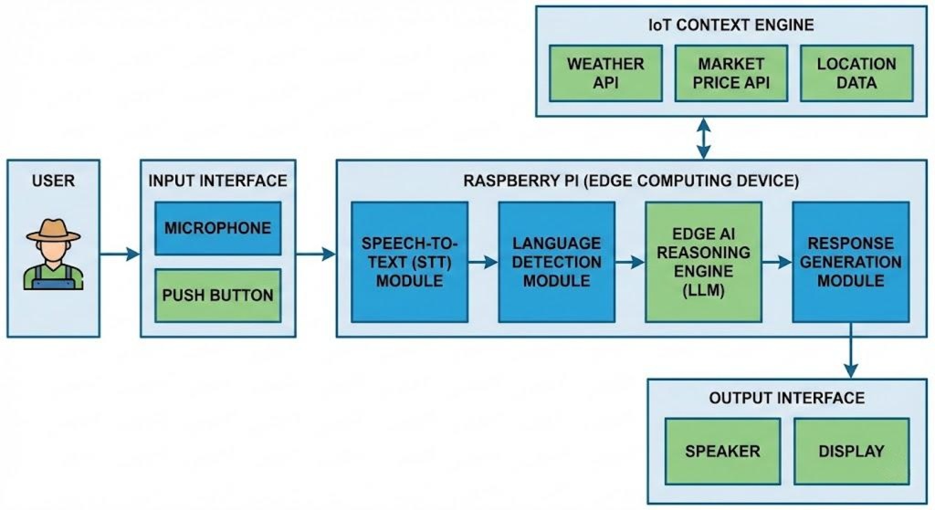
ARCHITECTURE / BLOCK DIAGRAM

Slide 6
COMPONENTS USED
Hardware
Raspberry Pi (Processing Unit)
LCD / TFT Display (Output Screen)
Push Buttons / Keypad (Input Control)
Power Source (Battery / Power Bank)
Internet Module (Wi-Fi / Hotspot / Optional GSM module)
Software / Tools
Python Programming
AI Model / Chatbot API integration
Weather & Market price APIs
Raspberry Pi OS
Basic UI application for navigation

Slide 7
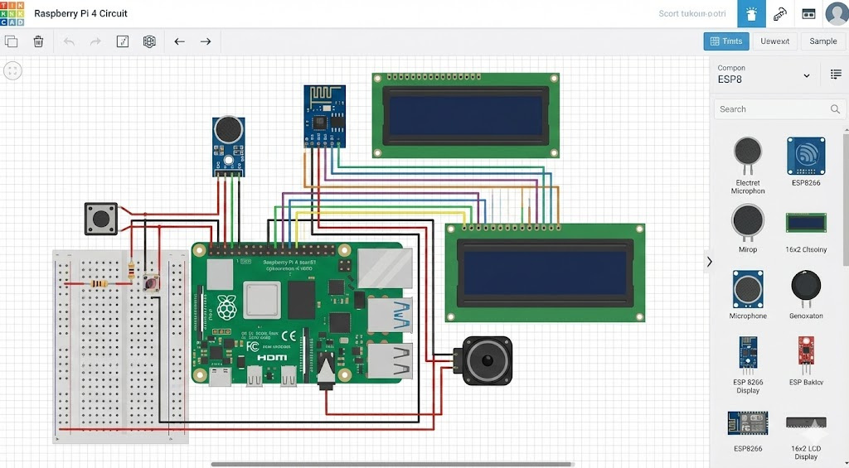
CONNECTIVITY DIAGRAM

Slide 8
NOVELTY
Works as a smart pocket device (no smartphone required).
Farmer-friendly interface using only buttons + simple display.
Provides real-time agriculture support using AI + APIs.
Combines multiple features in one device:
Weather Alerts
Crop recommendations
Market price updates
Disease guidance support
Designed specifically for rural accessibility and low digital literacy users.
Can be extended to support Tamil/Hindi/other regional languages.
Portable solution for on-field decision making.

Slide 9
RELATED WORK
S.No | Title (with link) | Authors | Year | Methodology / Frameworks / Tools / Approach | Research Gap / Limitation / Remarks
1 | Smart crop disease monitoring system in IoT using deep learning (Nature) | A. Saini et al. | 2025 | IoT network + Deep Learning model, monitoring + classification | Mainly disease monitoring; does not provide a portable farmer assistant device with UI/buttons
2 | Edge-aware CPS for plant disease detection (EdgePlantNet) (ScienceDirect) | M. Zeeshan et al. | 2025 | Lightweight attention CNNs + Edge-aware CPS | Focused on edge detection accuracy; lacks market+weather+assistant integration
3 | Edge-enabled smart agriculture framework integrating IoT + lightweight DL + agentic AI (ScienceDirect) | M.U. Tariq et al. | 2025 | IoT + lightweight DL + rule-based agentic AI + edge | More framework-based; not designed as a simple offline-friendly pocket device
4 | Deep Learning and IoT Fusion for Crop Health Monitoring (IET) (ietresearch.onlinelibrary.wiley.com) | T.K. Njoroge et al. | 2025 | IoT sensing + edge optimization + DL fusion model | Uses advanced optimization; still not aimed for non-smartphone farmers
5 | Emerging technologies for smart and sustainable precision agriculture (Springer) (Springer) | M. Padhiary et al. | 2025 | IoT + AI + ML + cloud + automation review | Review paper only; no real working pocket assistant prototype
6 | Edge computing-oriented smart agricultural supply chain (Springer) (Springer) | Q. He et al. | 2024 | Edge computing + IoT supply chain support | Supply-chain centered; not direct farmer-level handheld solution
7 | How IoT technology improves agricultural efficiency: A review (Springer) (Springer) | A.L. Duguma et al. | 2024 | IoT adoption review, interoperability + scalability discussion | Highlights IoT issues but doesn’t propose device UI solution
8 | A comprehensive review on smart & sustainable agriculture using IoT (Elsevier / ScienceDirect) (ScienceDirect) | V. Kumar et al. | 2024 | IoT agriculture review, applications and challenges | Doesn’t provide an implementation for farmers without smartphones
9 | Internet of Things (IoT) in digital agriculture: An overview (Elsevier Pure) (Idaho National Laboratory) | S. Dhal et al. | 2024 | Overview of IoT platforms + WSN + cloud + big data | General overview; lacks practical low-cost portable design
10 | Edge computing for sustainable agriculture: A survey (IEEE Access) (ResearchGate) | Y. Li, X. Xu, C. Yang | 2022 | Edge computing survey for agriculture + IoT + sustainability | Survey paper, no hardware UI/field-ready pocket assistant

Slide 10
REFERENCES
[1] A. Saini, N. S. Gill, and M. A. Shah, “Smart crop disease monitoring system in IoT using optimization enabled deep residual network,” Scientific Reports, vol. 15, 2025.
Link: https://www.nature.com/articles/s41598-025-85486-1
[2] M. Zeeshan et al., “EdgePlantNet: Lightweight edge-aware cyber–physical system for plant disease detection using enhanced attention CNNs,” Pervasive and Mobile Computing, Elsevier, 2025.
Link: https://www.sciencedirect.com/science/article/abs/pii/S1574119225000483
[3] M. U. Tariq et al., “Edge-enabled smart agriculture framework: Integrating IoT, lightweight deep learning, and agentic AI for context-aware farming,” Results in Engineering, Elsevier, 2025.
Link: https://www.sciencedirect.com/science/article/pii/S2590123025033973
[4] T. K. Njoroge, E. J. Omol, and V. O. Nyangaresi, “Deep learning and IoT fusion for crop health monitoring: A high-accuracy, edge-optimised model for smart farming,” IET Image Processing, 2025.
Link: https://ietresearch.onlinelibrary.wiley.com/doi/full/10.1049/ipr2.70208
[5] M. Sowmiya and R. Karthik, “IoT enabled prediction of agriculture’s plant disease using improved quantum whale optimization and deep learning,” Smart Agricultural Technology, Elsevier, 2023.
Link: Add a little bit of body text

Slide 11
[6] Q. He et al., “Edge computing-oriented smart agricultural supply chain management: A systematic review,” Multimedia Tools and Applications, Springer, 2024. https://link.springer.com/article/10.1007/s11042-024-18489-7
[7] A. L. Duguma et al., “How IoT technology improves agricultural efficiency: A systematic literature review,” Artificial Intelligence for Agriculture, Elsevier, 2024. https://www.sciencedirect.com/science/article/pii/S2589721724000197
[8] V. Kumar et al., “Smart and sustainable agriculture using IoT and AI: A comprehensive review,” Internet of Things, Elsevier, 2024. https://www.sciencedirect.com/science/article/pii/S2542660524000586
[9] S. Dhal et al., “Internet of Things (IoT) in digital agriculture: A comprehensive overview,” Journal of Agriculture and Food Research, Elsevier, 2024. https://www.sciencedirect.com/science/article/pii/S2666154324000493
[10] A. Rehman et al., “Smart Agriculture: An Overview of IoT, Edge Computing, and Machine Learning for Sustainable Farming,” IEEE Access, 2022. https://ieeexplore.ieee.org/document/9705201

